Slide 1
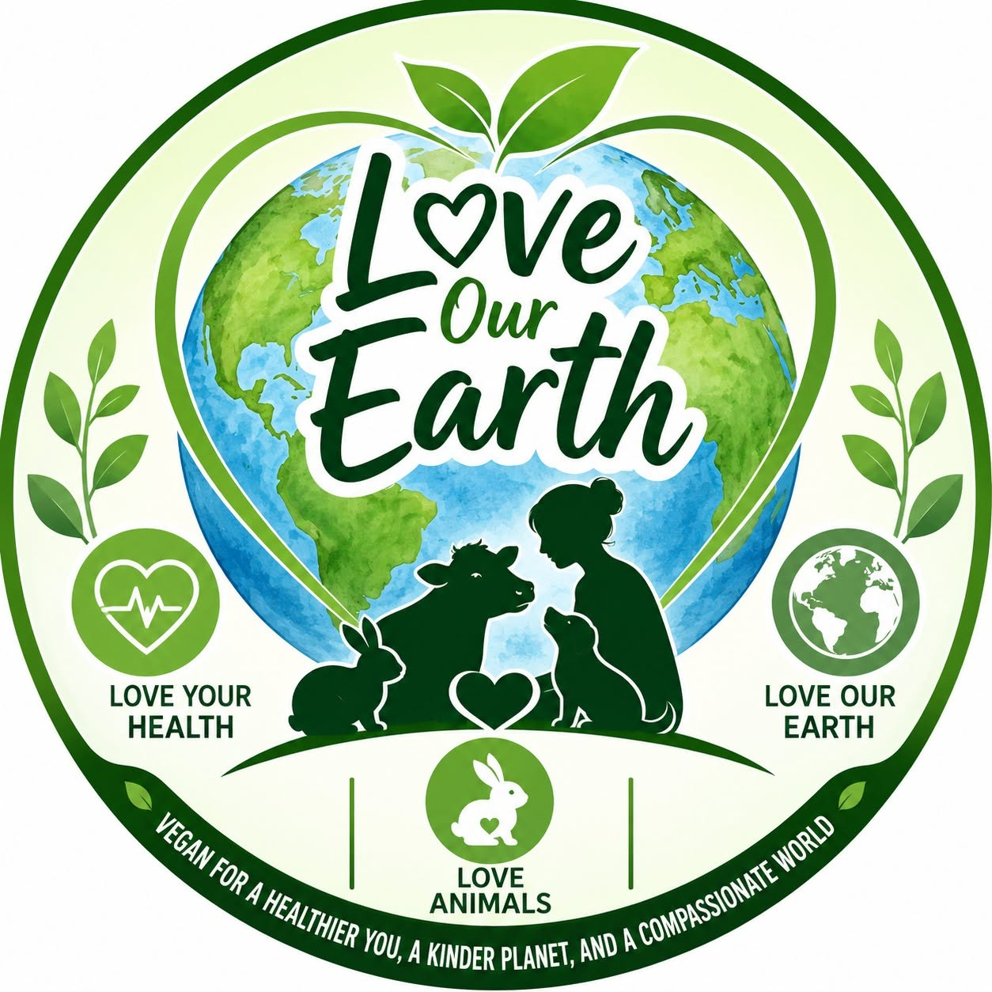
A LOVE OUR EARTH CAMPAIGN
Three Reasons
to Choose Vegan
Vegan for a healthier you, a kinder planet,
and a compassionate world.
loveourearth.com.au

Slide 2



One choice. Three reasons.
What if a single daily choice — what you put on your plate — could protect your body, help heal the planet, and spare billions of living creatures from suffering? The case for plant-based eating comes down to three simple ideas.
REASON 1
REASON 2
REASON 3
Love Your Health
Love Our Earth
Love Animals
Lower your risk of heart disease, cancer and diabetes — and feel the difference in energy and sleep.
The single most powerful personal action you can take to cut emissions, land use and water waste.
Spare sentient, intelligent animals from a lifetime of suffering on factory farms.

Slide 3

REASON 1
Love Your Health
Your body was built to thrive on plants.

Slide 4
The science is settled
A 2023 review of 76 studies and 2 million people found that the more closely people ate plant-based, the lower their risk of diabetes, heart disease, cancer and early death.
25%
34%
Lower cancer risk in vegetarians vs meat-eaters
Reduction in risk across 1.8 million people (University of Oxford).
lower risk of dying from heart disease (Nutrients)
lower risk of high blood pressure vs meat-eaters
£6.7B
1
saved a year if England switched to plant-based
supplement you truly need: cheap daily B12

Slide 5
Feel the difference — fast
The benefits aren't only long-term. In a 2021 Vegan Society survey, people reported real improvements within weeks of going vegan.
“But what about…”
What people noticed after going vegan
Share of new vegans reporting each improvement.
Protein?
Tofu and tempeh are complete proteins on their own. A varied diet of beans, grains, nuts and seeds easily supplies all nine essential amino acids.
Vitamin B12?
Just one inexpensive daily tablet. B12 is made by microbes, not animals — farmed animals are supplemented with it anyway.
Skipping fish?
You also skip mercury, PFAS “forever chemicals” and microplastics, which build up in seafood and your body.

Slide 6

REASON 2
Love Our Earth
Of everything you can do for the planet, your fork matters most.

Slide 7
Your fork is your climate superpower
The IPCC names switching to plant-rich diets as one of the highest-impact climate actions an individual can take. The data is hard to argue with.
57%
A vegan diet's environmental footprint
of food-related greenhouse gases come from animal farming — twice that of all plant foods combined.
A vegan diet has just 30% of the impact of a high-meat diet (55,000 people, Nature Food).
80%
of the world's farmland is used for livestock, yet it yields only a fraction of our calories.
70%
potential cut in food-system emissions by 2050 with a global shift to plant-based diets (The Lancet).

Slide 8
Lighter on land, water and life
Plants turn resources into food far more efficiently than animals — sparing forests, fresh water and the species we share the planet with.
76%
Water to produce 1 kg of food
Less land per person
Lentils are roughly 12× more water-efficient than beef.
Shifting to plants could cut the land used to feed each of us by up to 76% — easing pressure on the Amazon.
1M
Species at risk
The UN warns ~1 million species face extinction, driven mostly by agriculture — led by animal farming.
35%
Of fish stocks overfished
Bottom trawling alone emits as much carbon a year as all of global aviation.

Slide 9

REASON 3
Love Animals
They feel pain. They fear death. They deserve better.

Slide 10
The scale of suffering
The numbers are almost too large to picture — and the science now formally recognises these animals as sentient beings.
83B
200B+
10
land animals slaughtered for food in 2022 — a figure that has climbed every year for six decades.
animals killed each year once farmed fish are counted — dwarfing the land-animal total.
factory-farmed animals raised and killed for every person on Earth, every single year.
The science of animal consciousness is settled
The 2024 New York Declaration on Animal Consciousness — led by NYU, York University and the LSE — affirms strong scientific support for consciousness in all mammals and birds, and a realistic possibility of conscious experience in all vertebrates, including fish.
“Farm animals feel pleasure and sadness, excitement and resentment, depression, fear and pain.” — Dr Jane Goodall

Slide 11
Smarter than we ever imagined
These are not objects — they are individuals living their own lives, almost all of them on factory farms.
Share of US farm animals on factory farms
Pigs
Almost every animal farmed for food in the US lives on a factory farm.
Solve mazes, use mirrors to find hidden treats, and can even play simple video games.
Chickens
Plan ahead, grasp cause and effect, and exercise self-control.
Cows
Have “eureka” moments, form deep social bonds, and recognise each other's faces.

Slide 12

The choice that changes everything
Love your health — a plant-based diet protects your heart, lowers cancer risk, and lets your body thrive.
Love our Earth — rainforests, water and biodiversity need us to eat differently — and small choices scale.
Love animals — because they feel, they suffer, and most of us would say: not like this, not for me.
Go Vegan.
Every meal is a vote for the world you want to live in.
loveourearth.com.au

